Slide 1



Predicting the Philadelphia Eagles 2023 Season
Nick Videtti
IST 718 - Big Data Analytics
Summer 2023

Slide 2
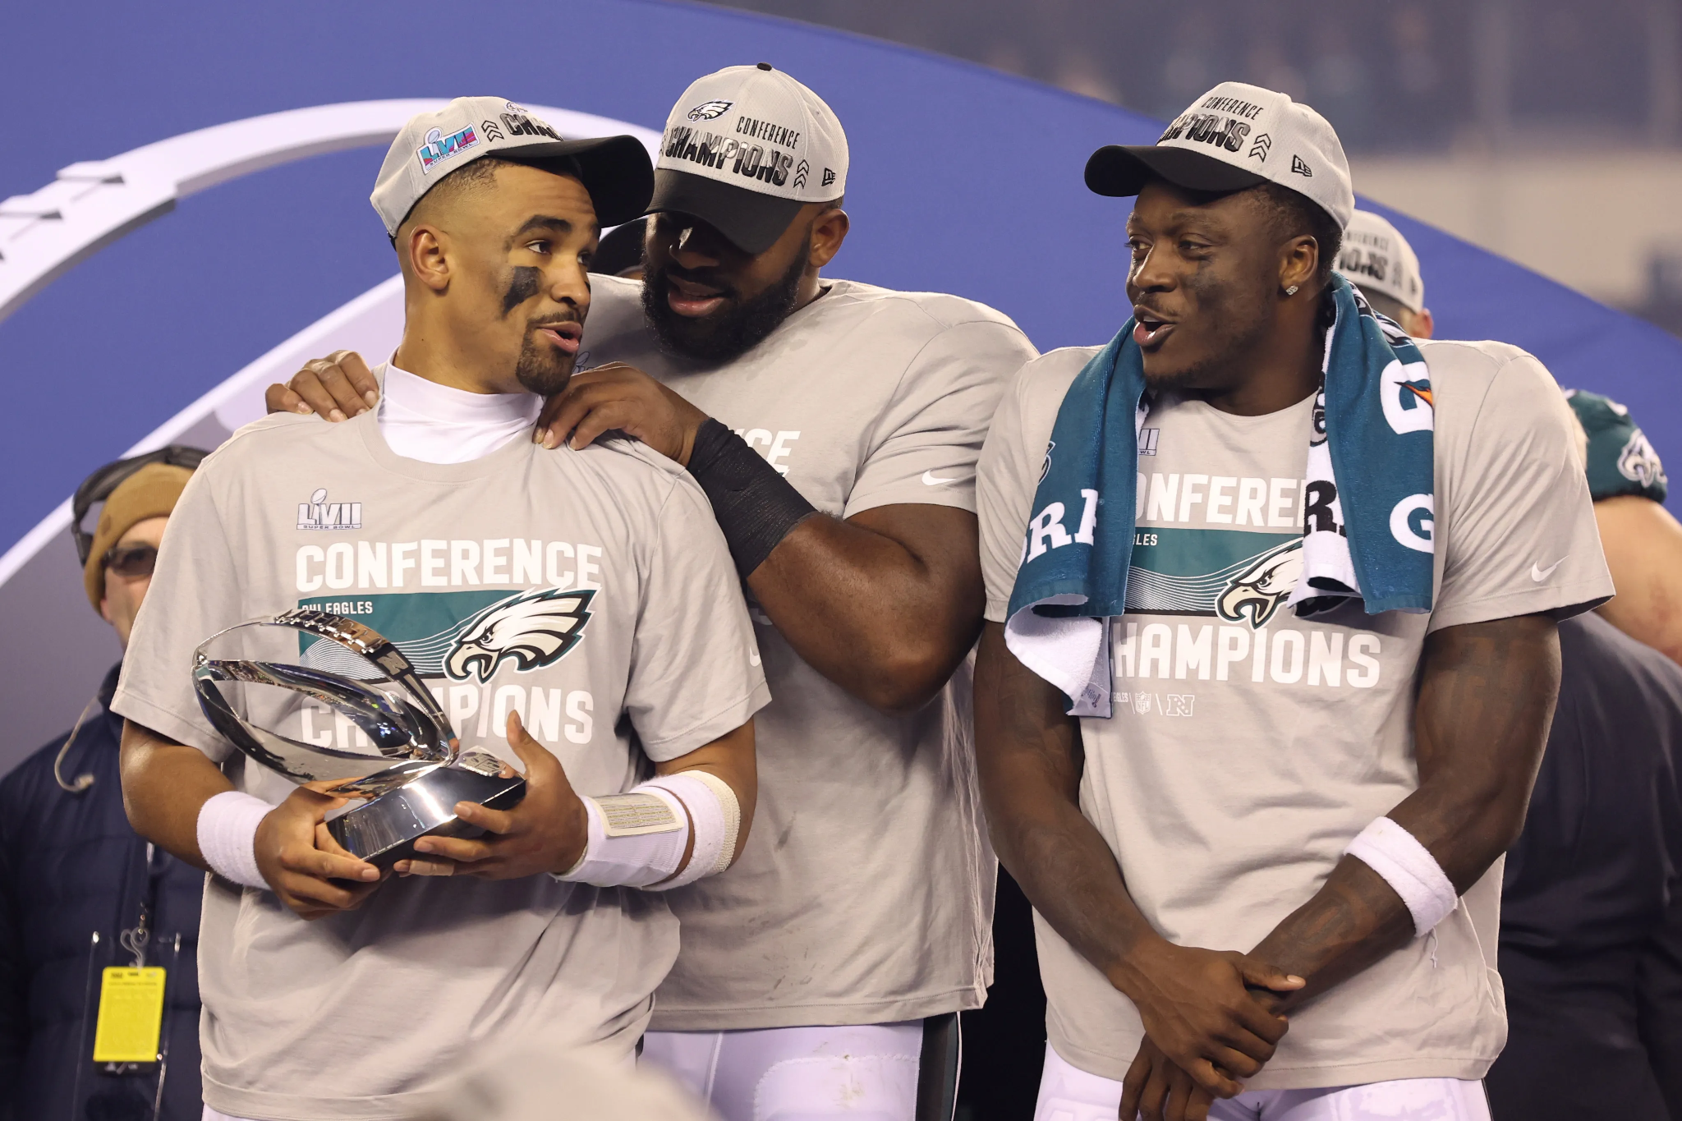

Project Summary
Eagles lost Super Bowl LVII in February 2023
Teams have hard time bouncing back win or loss
Will Eagles bounce back in 2023?
Won NFC Championship Game 31-7
Advance to Super Bowl LVII
Lost Super Bowl LVII 38-35

Slide 3



Data Summary
Using data from the well-known and reliable site Pro Football Reference (https://www.pro-football-reference.com/)
All Super Bowl matchups
Year-by-year season statistics throughout team history for all 32 NFL teams
Notable Fields in Super Bowl Data
Winning Team
Losing Team
Score
Year / Season
Notable Fields in Team History Data
Season
Wins / Losses / Ties
Playoff Success
Point Differential
Standing in Division
Offensive Ranking / Defensive Ranking
Yards

Slide 4
Project Goals
O - Combine data for all team history and super bowls
S - Clean/Validate/Manipulate data as needed
E - Create insights on how teams perform the year after losing the Super Bowl via EDA and Visualization
M - Model to predict Eagles 2023 season success with various algorithms
iN - Use most accurate model to make a prediction

Slide 5
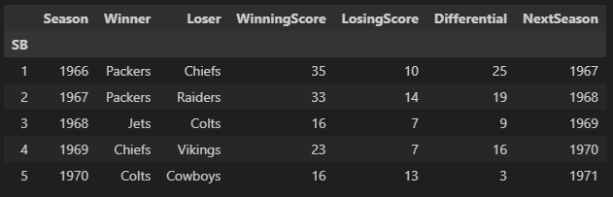
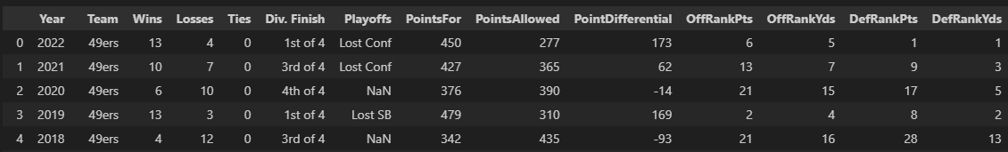
Cleaned DataFrames

Slide 6
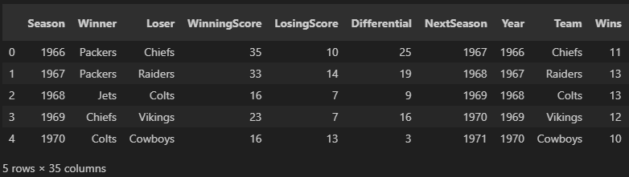

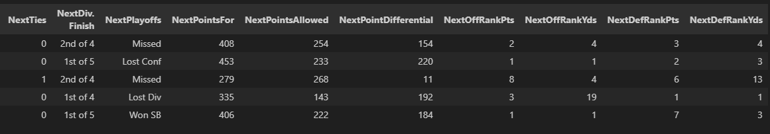
Cleaned, Combined, and Filtered DataFrame for Super Bowl Losers

Slide 7
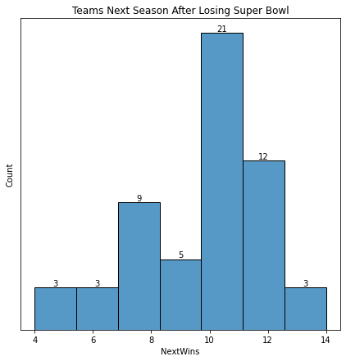
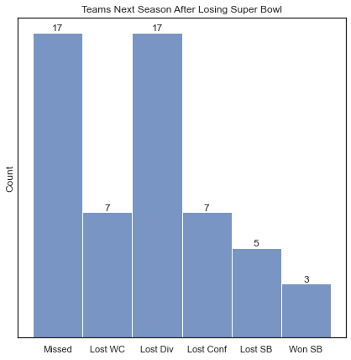
Exploratory Data Analysis

Slide 8
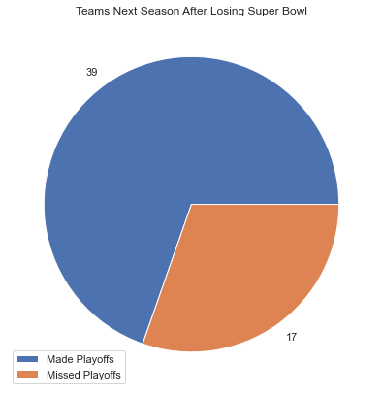
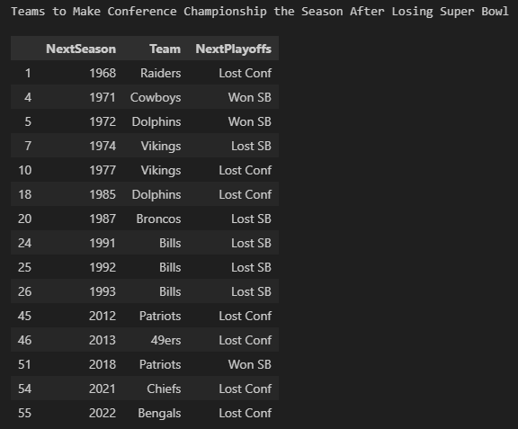
Exploratory Data Analysis Cont’d…

Slide 9
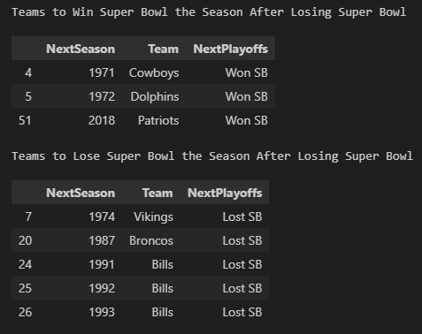
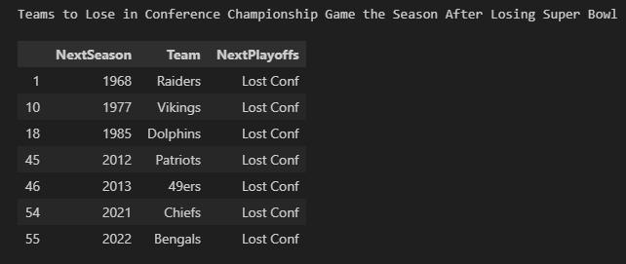
Exploratory Data Analysis Cont’d…

Slide 10
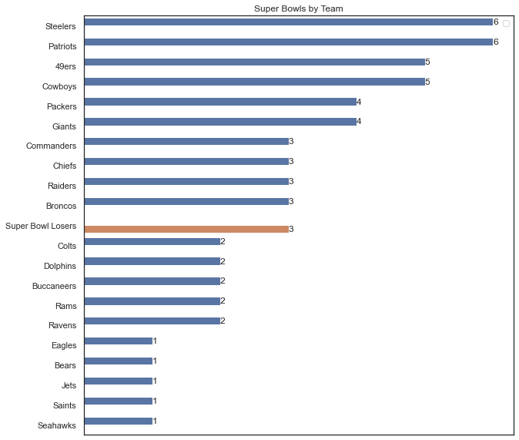
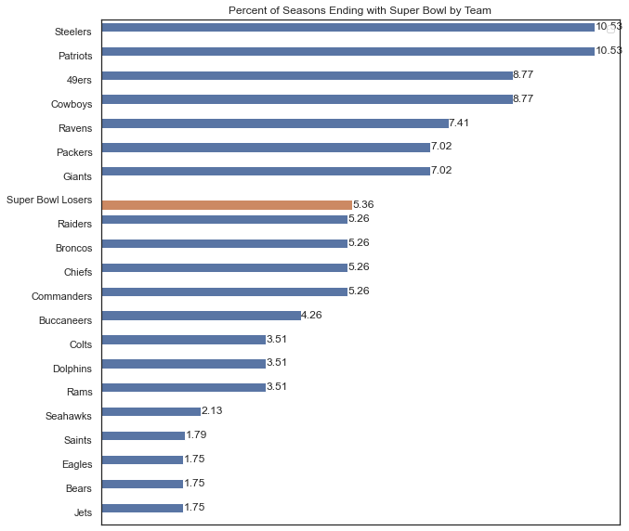
Exploratory Data Analysis Cont’d…

Slide 11
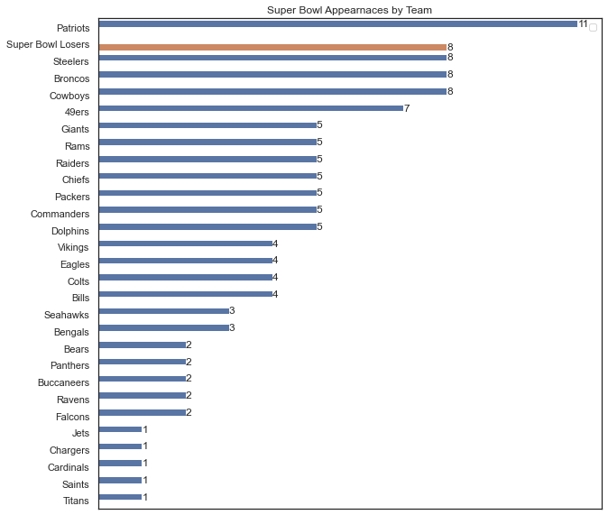
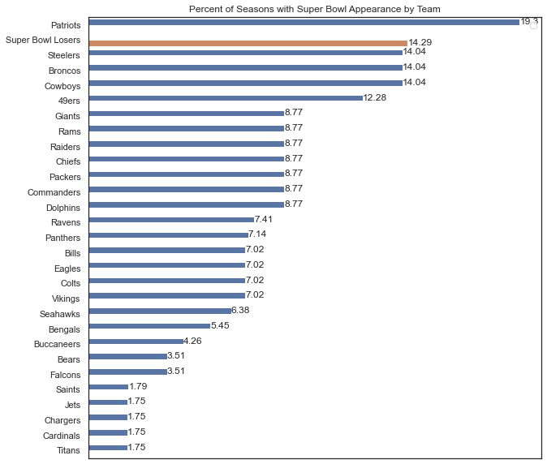
Exploratory Data Analysis Cont’d…

Slide 12
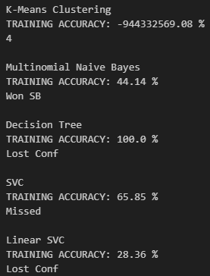
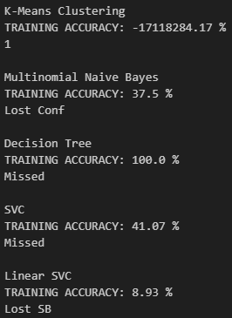
Modeling
Team Seasons Data
Super Bowl Losers Data

Slide 13
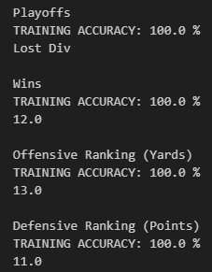
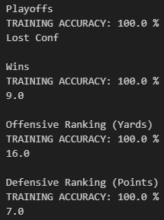
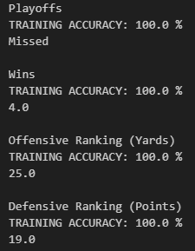
Modeling Cont’d…
Chiefs 2023 Predictions
Bills 2023 Predictions
Jets 2023 Predictions

Slide 14
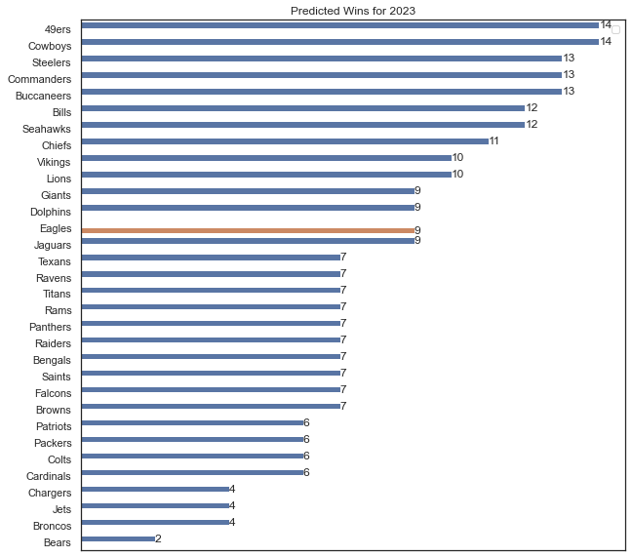
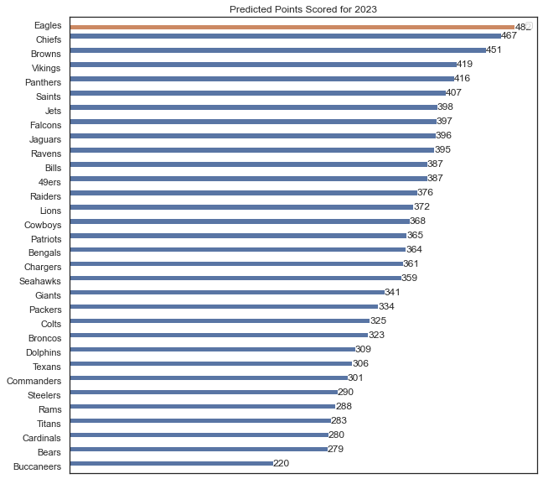
Interpreting

Slide 15
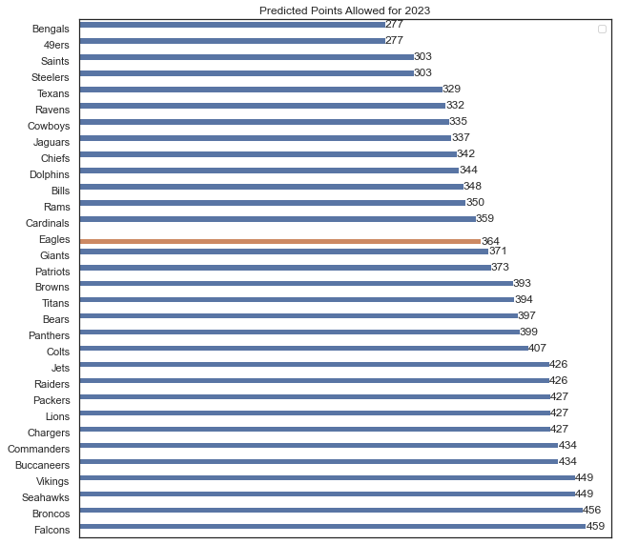
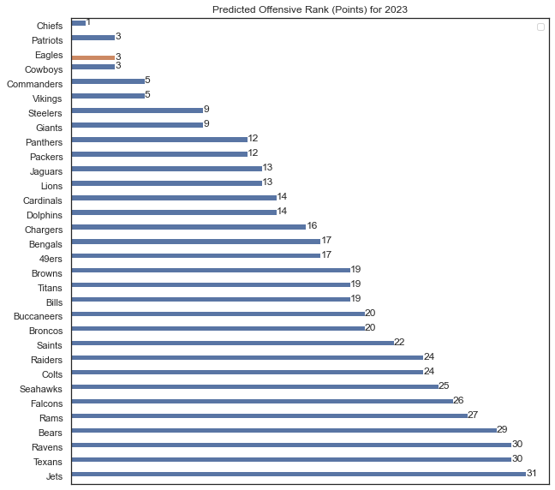
Interpreting Cont’d…

Slide 16
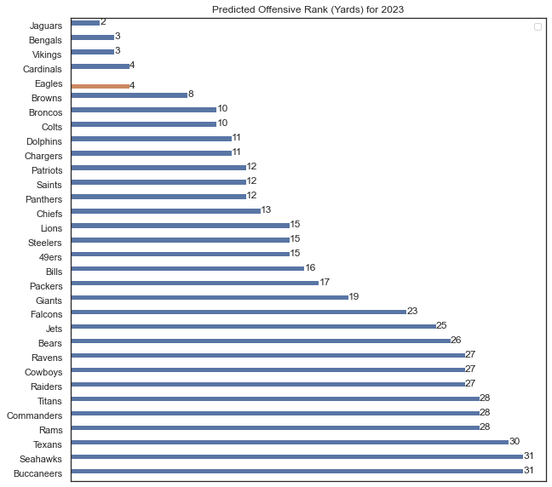
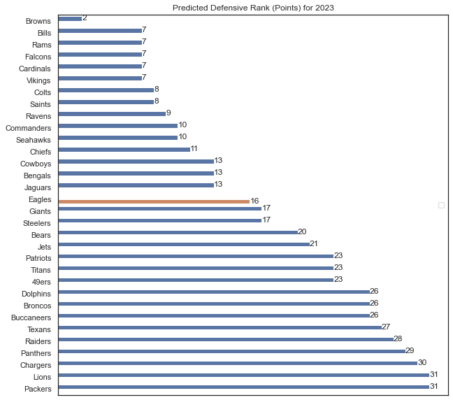
Interpreting Cont’d…

Slide 17
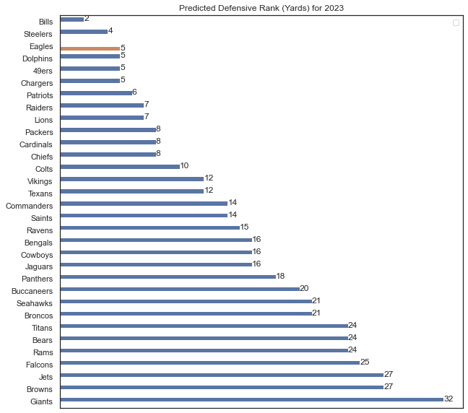
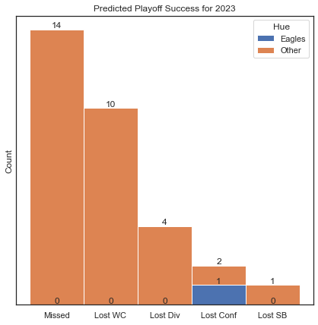
Interpreting Cont’d…

Slide 18
Conclusion
Predictions need constraints
Predicting vector of values instead of separate predictions for each value
Tuning models to improve accuracy

Slide 19
Thank You!

